Slide 1

Token Selection

Slide 2
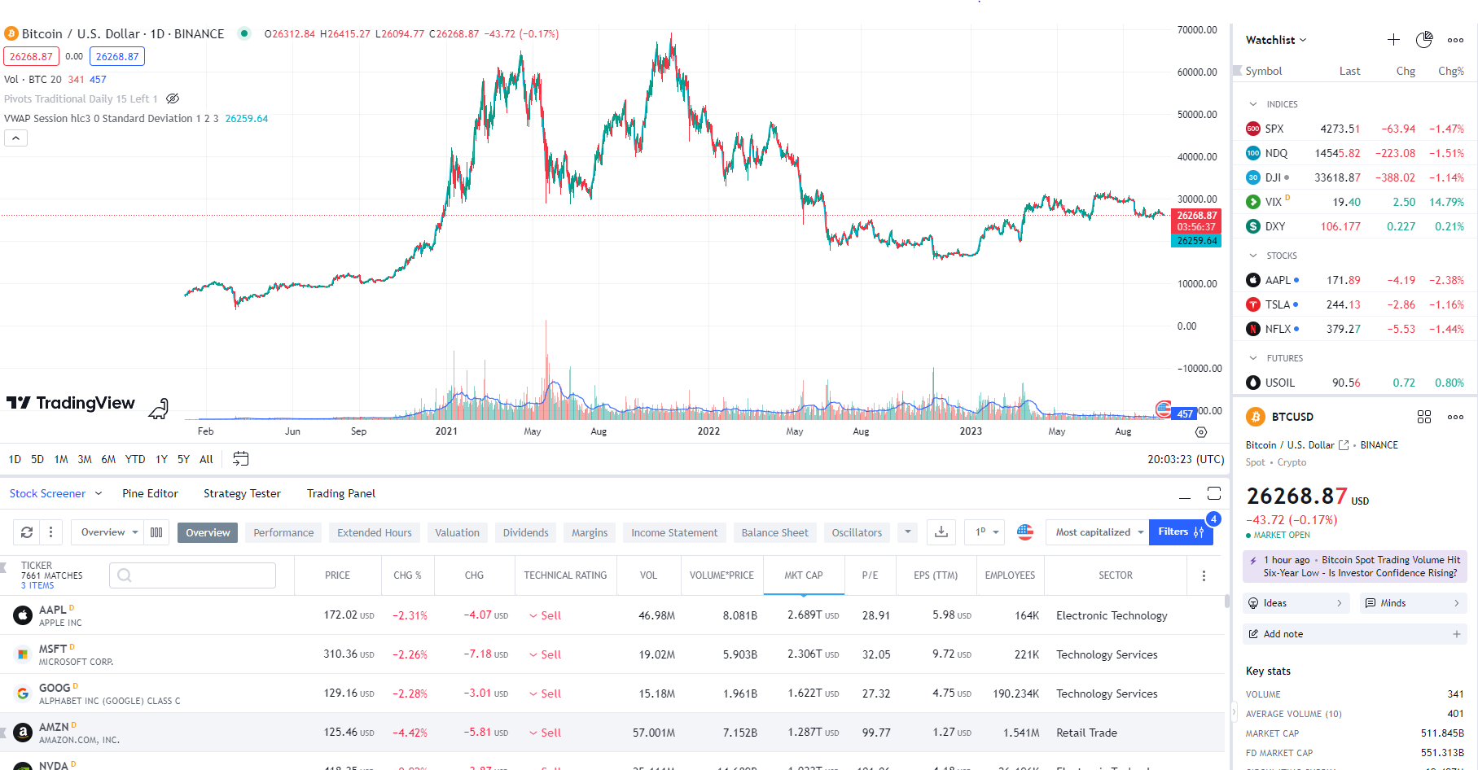
Screener

Slide 3
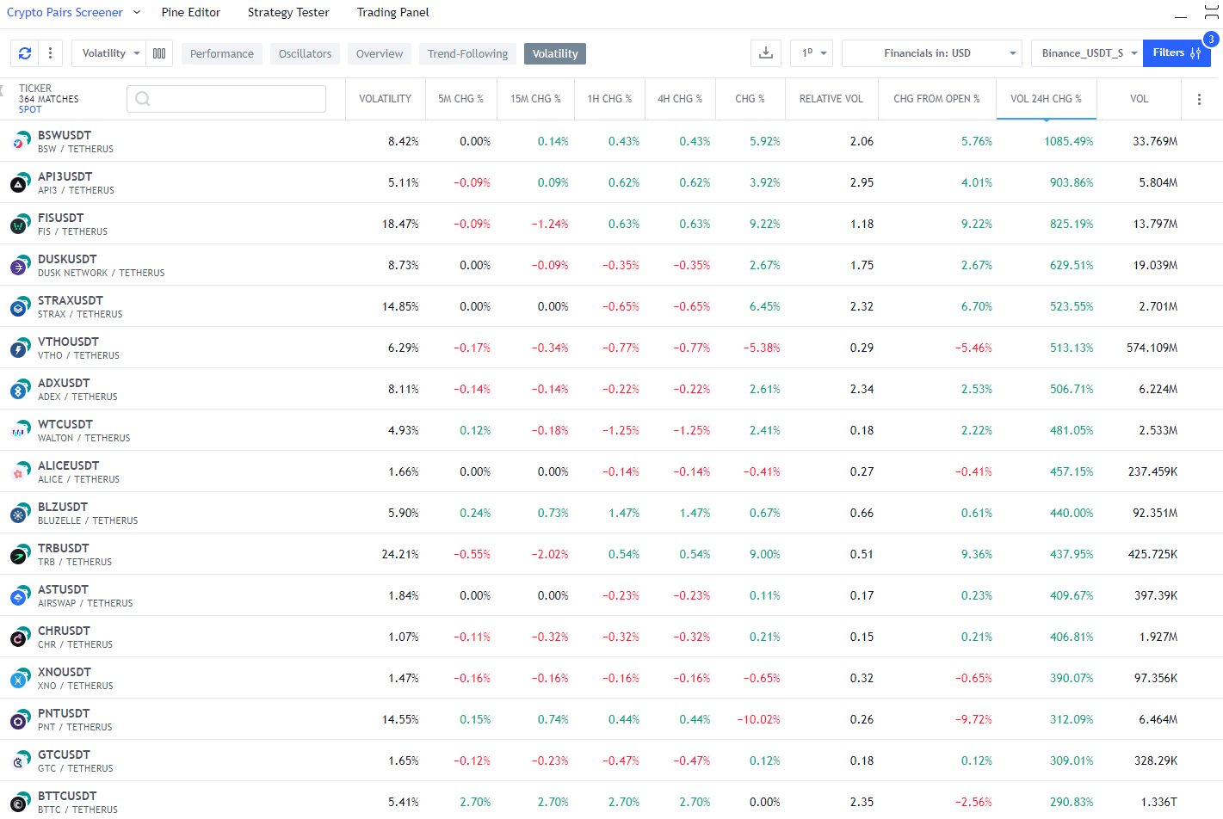
Crypto Screener

Slide 4
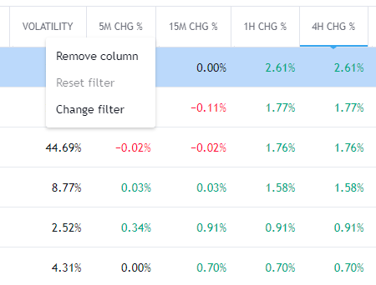
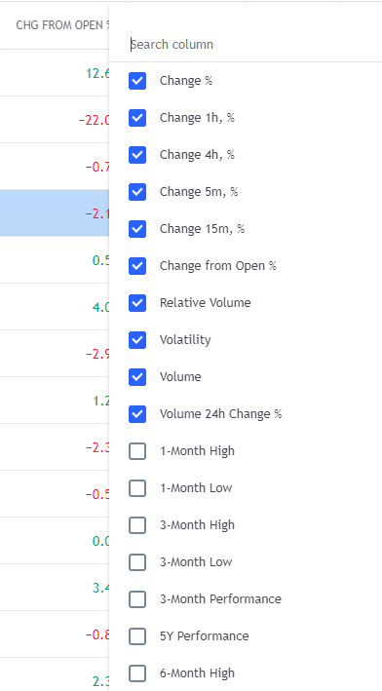
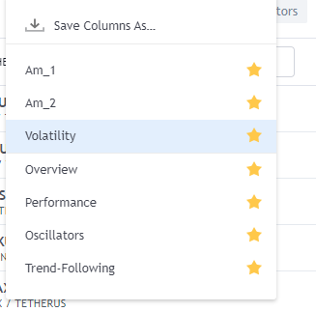
Column Selection

Slide 5
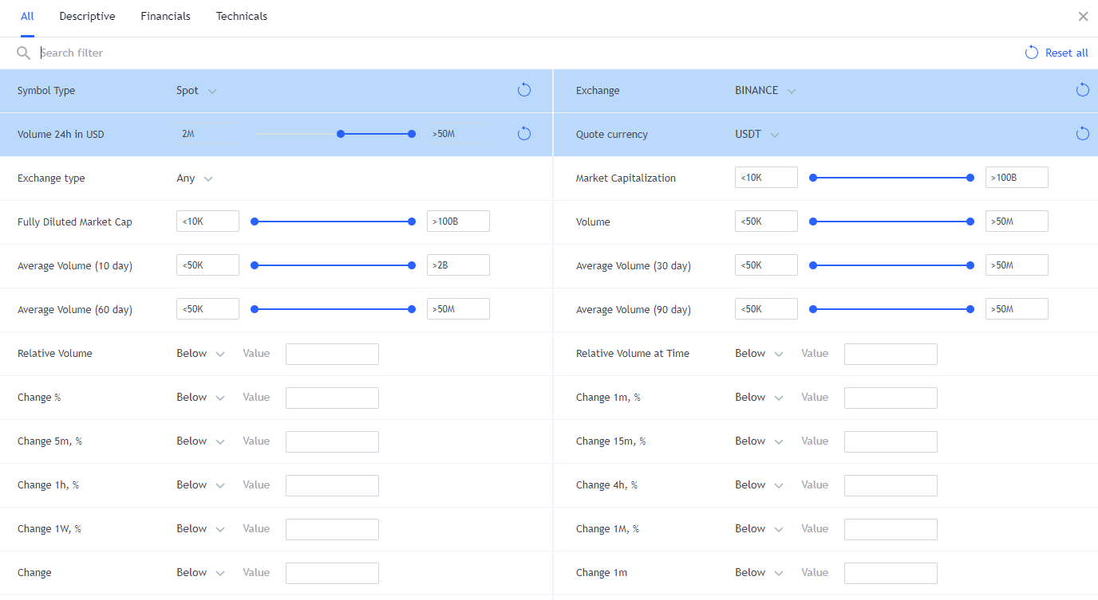
Pair Selection

Slide 6
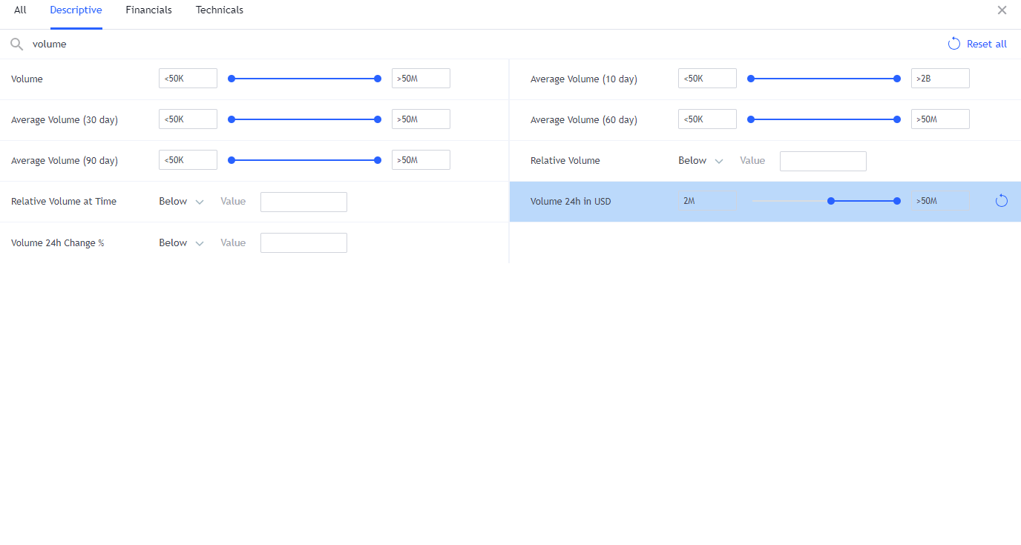
Volume Screening

Slide 7

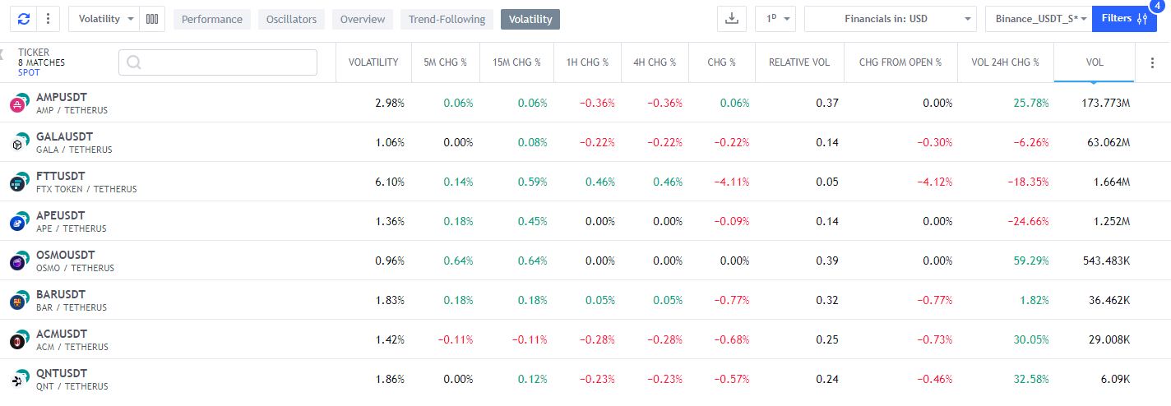
RSI Screening I

Slide 8


RSI Screening II

Slide 9

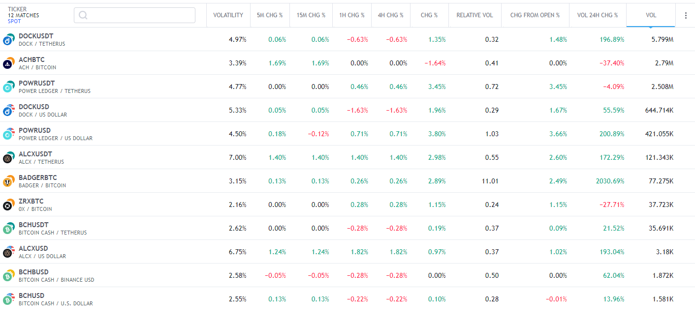
EMA Screening I

Slide 10


EMA Screening II

Slide 11
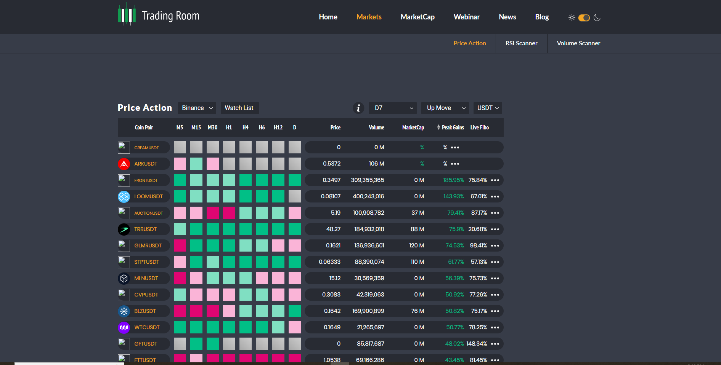
Additional Resources
https://tools.tradingroom.io/

Slide 12
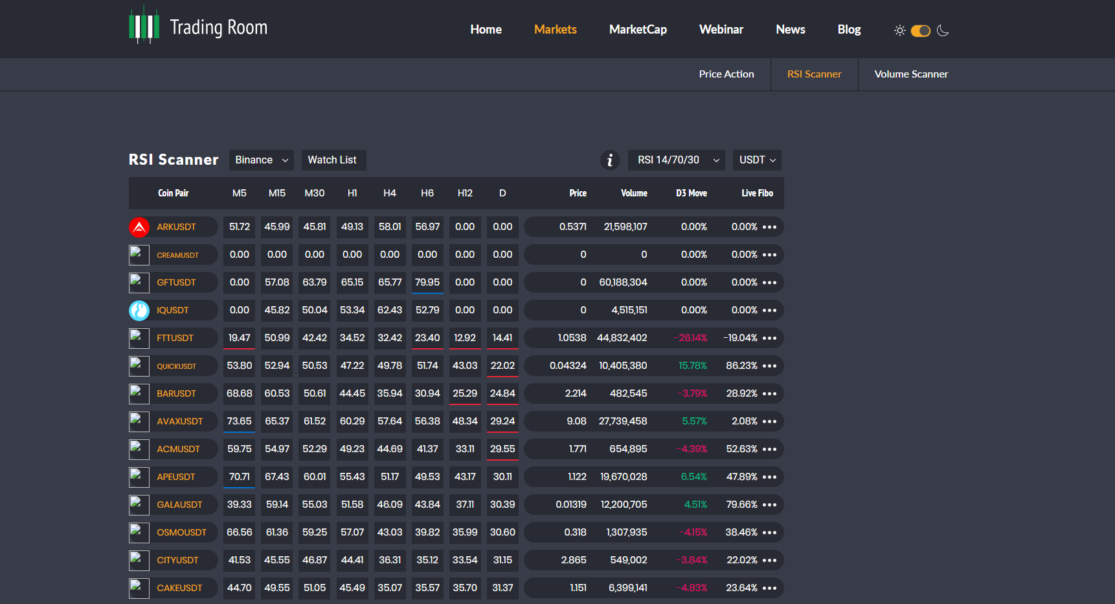
Additional Resources

